Slide 1
Internet of Things– Conceptual Frameworks and Architecture
1

Slide 2
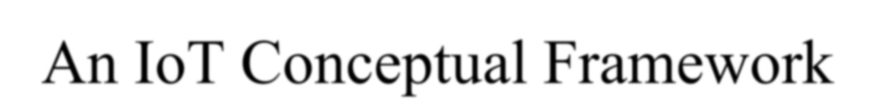
An IoT Conceptual Framework
Physical Object + Controller, Sensor and Actuators + Internet = Internet of Things.
Source: An equation given by Adrian McEwen and Hakim
Cassimally, ‘Designing Internet of things’, Wiley, 2014
2

Slide 3
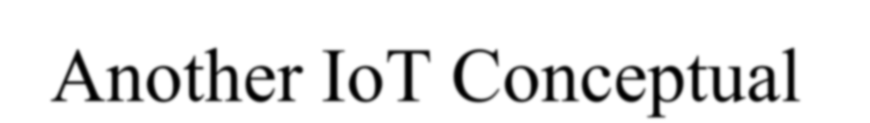
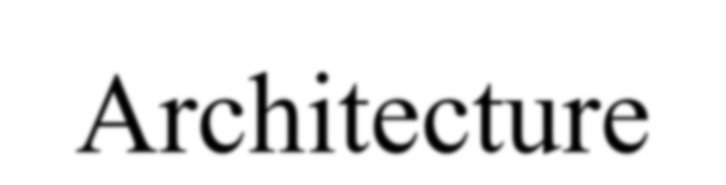
Another IoT Conceptual Architecture
Gather + Enrich + Stream + Manage
+ Acquire + organize and Analyse = Internet of Things Enterprise & Business Applications, Integration
and SoA( oracles IOT architecture
3

Slide 4
Gather
Enrich
Stream
Manage
Acquire
Organize
and
Device Identity
Network
Data Centre Mgmt.
Analyse
Server
Comm. Mgmt
Mgmt & access Mgmt.
Mgmt
Smart Sensor
Application Framework
Protocol
Business Intelligence
IoT Comm. Framework
Handlers
Device Identity Database
Big Data Store
Gateway
Message Router
Application Framework
Network
Internet Firewall
Database Firewall
Sensor
Device Access Mgmt
Key Value Data Store
Application Framework
Message Cache
IoT Comm. & Mgmt Proxy
IoT Comm.
Device Indentit y Mgmt
Database
RDBMS
Framework
IoT Comm.
Framework
Device Mgmt.
Data
Routing &
Enterprise Integration
Analysis
Mgmt.
Chapter-1L02: "Internet of Things " , Raj Kamal,
Figure^{Pu}1^{bl}.^{s}5^{.: M}O^{cG}r^{ra}a^{w}c^{-H}l^{i}e^{ll}’^{E}s^{du}I^{c}o^{ati}T^{on} Architecture
7

Slide 5
1At level 1 data of the device using sensors or the things gather the pre data
2 A sensor connected to the a gateway, functions as a smart sensor(smart sensor refers to as a sensor with computing and communication capacity). The data then enriches at level 2 for example by transcoding at the gateway. Transcoding means coding or decoding before data transfer between two entities.

Slide 6
3 At level 3 a communication management system sends or receives data streams.
4 Device management , identity management and access management subsystems receives the device’s data at level 4
5A data store or database acquires the data at level 5

Slide 7
6 Data routed fro the devices and things organizes and analyses at level 6. for example data is analyzed for collecting business intelligence in business processes.

Slide 8
Another IoT Conceptual Framework
Gather + Consolidate + Connect + Collect + Assemble + Manage and Analyse = Internet of Things
connected to Cloud Services … (1.3) [An Equation based on the IBM Framework for the Framework blocks and components.]
8

Slide 9
Sensors
Connect + Collect + Assemble +Manage
Cloud Infrastructure
Gather Gateway
Informix
Assemble events from the IoT into logic flows.in Database
Firewall
Data
Network
Time series
Data Centre Mgmt. |  |  | Server Mgmt
Smart Sensor
consolidation
Comm. Mgmt
service
Application Framework
Device Register and connect
Sensor
Internet Firewall
IoT Comm. Framework
Protocol Handlers MQTT
In-memory Analytics and Intelligence
Big Data
Gateway
Sensor
Data Consoli- dation Framework
Network
Store
Collect from things.
NoSQL
Application Framework
Message Sight
IoT Comm. Framework
IoT Comm.
Framework
Message
Manage
a time- series view of data
Relational Time Series service
Router
Message Cache
Spatial Storage and Real Time Analytics Mgmt.
Publish/ Subscrib
Manage connections and
e
Subscriptions
Consumer/Business
CH01 Fig. 1^{P}.^{u}3^{bls}I.:B^{M}M^{cGraw}I⁻o^{H}T^{ill E}C^{du}o^{ca}n^{tio}c^{n}eptual Framework
5

Slide 10
1 level 1 and 2 consists of sensor network to gather and consolidate the data. First level gathers the data from the sensors and send it to the gateway, the data then consolidates at the second level.
2 The gateway at the level 2 communicates with the data streams between levels 2 and 3. The system uses a communication –management subsystems at level 3

Slide 11
3 An information service consists of connect , collect, assemble and manage subsystems at level 3 and level 4. The service render from level 4.
4 Real time series analysis, data analytics and intelligence subsystems are also at level 4 and level 5. A cloud infrastructure, data store or database acquires the data at level 5.

Slide 12
IOT Architectural view
A model has multiple layers known as tiers. A reference model can be used to depict building blocks, successive interactions and integration

Slide 13
Level 7- Collaboration and processes (involving peoples and business processes)
Level 6- Application (Reporting, Analysis, control)
Level 5- Data Abstraction (Aggregation and Access)
Level 4- Data Accumulation (storage)
Level 3- Edge Computing (data element analysis and transformation)
Level 2- Connectivity (Communication and Processing Units)
Level 1- Physical devices and Controllers (the things in IoT) [Sensors, machines, devices, Intelligent Edge nodes of Different Types
Ch01Fig. 1.4 An I_{C}O_{ha}T_{pte}r_{r-}e_{1L}f₀e₂r:e_{"I}n_{nt}c_{er}e_{net}m_{of} o_{Th}d_{in}e_{g}l_{s "}C_{, R}I_{a}S_{j K}C_{am}O_{al,}conceptual framework
Copyright © 2017
Publs.: McGraw-Hill Education
6

Slide 14
An architecture has the following features:
1 The architecture serves as a reference in application of IOT in services and business processes
2A set of sensors which are smart, capture the data, perform necessary data element analysis and transformation as per device application framework and connect directly to a communication manager.

Slide 15
3 A set of sensor circuits is connected to a gateway possessing separate data capturing, gathering, computing and communication capabilities. The gateway receives the data in one form at one end and sends it in another form to the other end.
4 The communication management subsystem has functionalities for device identity database, device management and access management.

Slide 16
5 Data routes from the gateway through the internet and data center to the application server or enterprise server which acquires that data.
6 Organization and analysis subsystems enable the services , business processes, enterprise integration and complex processes.

Slide 17
Sensors
Connect + Collect + Assemble +Manage
Cloud Infrastructure
Gather Gateway
Informix
Assemble events from the IoT into logic flows.in Database
Firewall
Data
Network
Time series
Data Centre Mgmt. |  |  | Server Mgmt
Smart Sensor
consolidation
Comm. Mgmt
service
Application Framework
Device Register and connect
Sensor
Internet Firewall
IoT Comm. Framework
Protocol Handlers MQTT
In-memory Analytics and Intelligence
Big Data
Gateway
Sensor
Data Consoli- dation Framework
Network
Store
Collect from things.
NoSQL
Application Framework
Message Sight
IoT Comm. Framework
IoT Comm.
Framework
Message
Manage
a time- series view of data
Relational Time Series service
Router
Message Cache
Spatial Storage and Real Time Analytics Mgmt.
Publish/ Subscrib
Manage connections and
e
Subscriptions
Consumer/Business
CH01 Fig. 1^{P}.^{u}3^{bls}I.:B^{M}M^{cGraw}I⁻o^{H}T^{ill E}C^{du}o^{ca}n^{tio}c^{n}eptual Framework
5

Slide 18
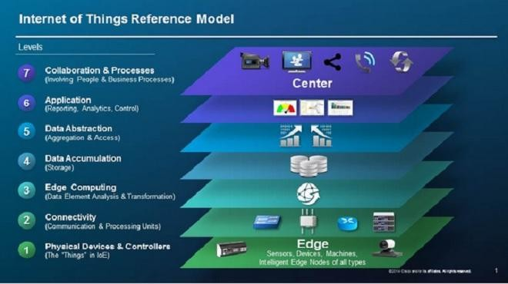
CISCO Reference Model for Internet of Things ()

Slide 19
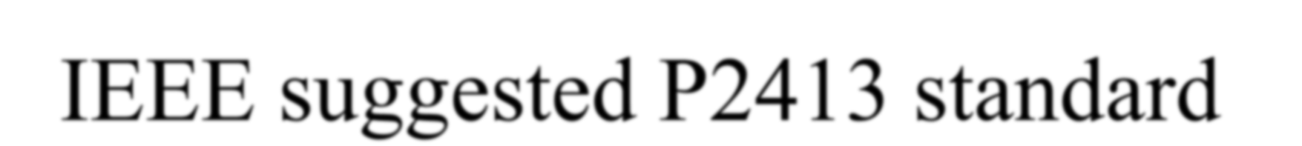
IEEE suggested P2413 standard
A reference architecture of IoT
Built upon the reference model(s)
Covers the definition of basic architectural building blocks and their integration capability into multi-tiered systems.

Slide 20
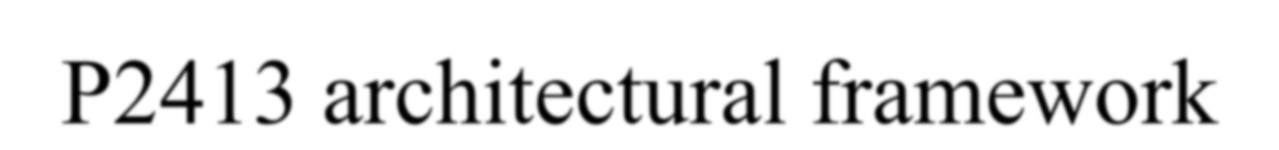
P2413 architectural framework
A reference model defining relation- ships among various IoT verticals, for example, transportation and healthcare
Follows top-down approach (means consider top layer design first and then move to the lowest)

Slide 21
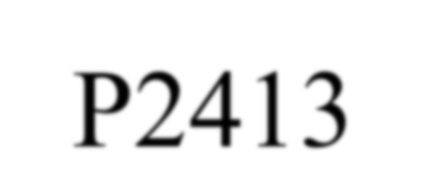
P2413
Defines no new architecture and no reinvent but existing architectures congruent with it
Gives a blueprint for data abstraction
Specifies abstract IoT domain for various IoT domains

Slide 22
P2413
Recommends quality ‘quadruple’ trust
“Protection, Security, Privacy, and Safety”
Strives for mitigating architecture divergence (s)
Addresses how to document

Slide 23
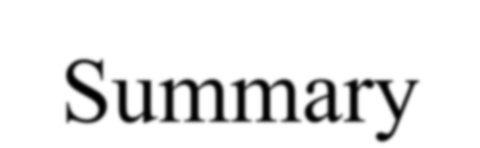
Summary
We learnt
Physical Object + Controller, Sensor and Actuators + Internet = Internet of Things
Gather + Enrich + Stream + Manage + Acquire + organize and Analyse = Oracle IoT Architecture

Slide 24
Summary
We learnt
Gather + Consolidate + Connect + Collect + Assemble + Manage and Analyse = IBM Architecture reference model/Conceptual framework
CISCO Reference model layers
IEEE Suggested P2413 standard for architecture of IoT

Slide 25
End of Lesson 2 on Internet of Things−
Conceptual frameworks and Architecture

